Slide 1
Eric Franco Carlos Maqueda Lee Taylor
xxxx

Slide 2
Project Objectives
Explore real estate prices and relevant pricing variables
Databases used:
Zillow
Census
IRS
Variables explored:
Mortgage Rates
Yield Curve
Average Income
Price Per Square Foot
Median Listing Price
Zillow Size Rank

Slide 3
Project Summary
We collected, cleaned and transformed data.
We collected the data and grouped it by year and zip code.
We investigated what improved accuracy of our predictive models, threw out the hogwash.
Developed a model that has an R^2 of 0.95

Slide 4
Limitations
Length of the data we have been able to use.
Income data was limited to buckets provided by the IRS
Incomplete datasets accounted for approximately 30% of all collected data.
This is for average housing prices in zip codes, not used for individual houses.
We did not create geographic tags to account for location.

Slide 5
Data Transformation Summary
Collect
Zillow Housing Data
BLS Employment Data
Merge
Converted data to annual data
Merge all data sets into a Master Data Frame
Clean
We removed all rows that had incomplete data for that year.
Output the data for analysis to CSVs.
IRS Income Data
We then merged on year and zip code

Slide 6
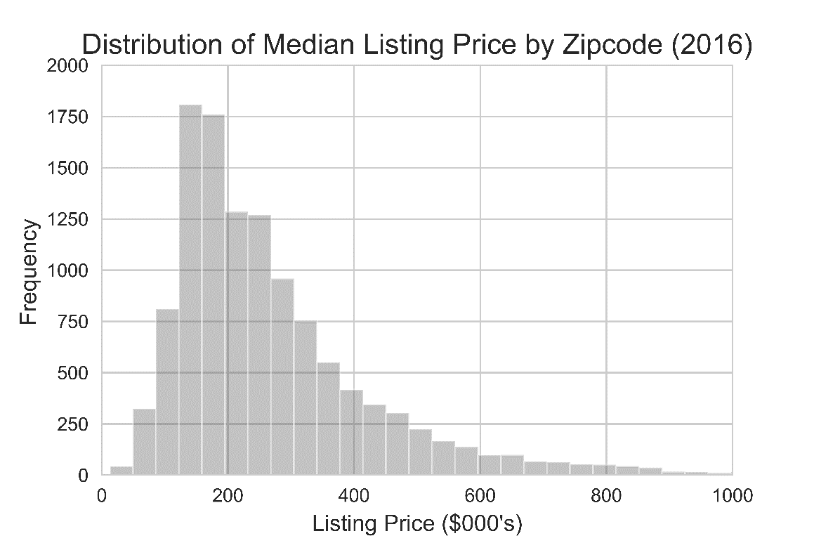
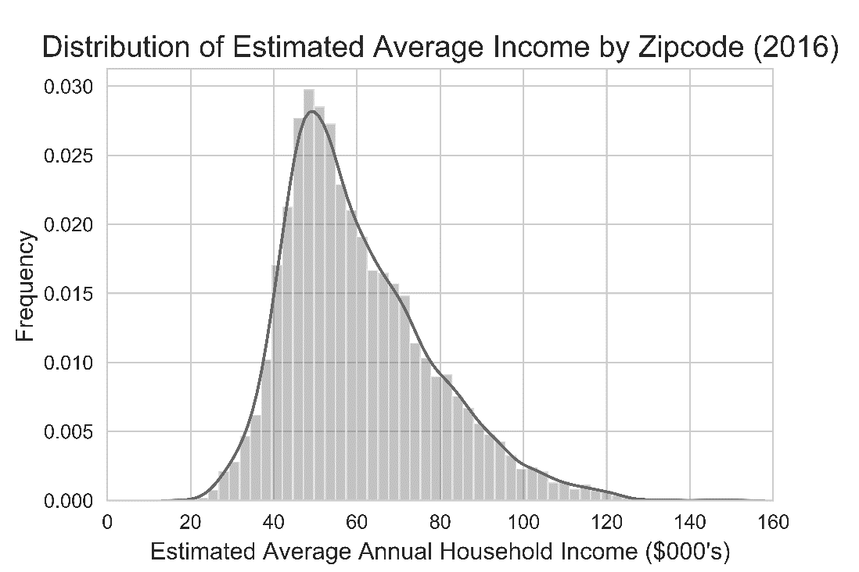
Exploratory Data Analysis Listing Price and Income
Listing Price
Median value ~$230k, with extreme skew to the upside
Mean: $292k
Median $230k
Standard deviation: $268k
Estimated Annual Income
Clustered near $60k
Data structure likely led to under-estimation of high-income ZIP codes
Mean: $60k
Median $57k
Standard deviation: $17k

Slide 7
Exploratory Data Analysis Income is a reasonable predictor of listing price

Slide 8
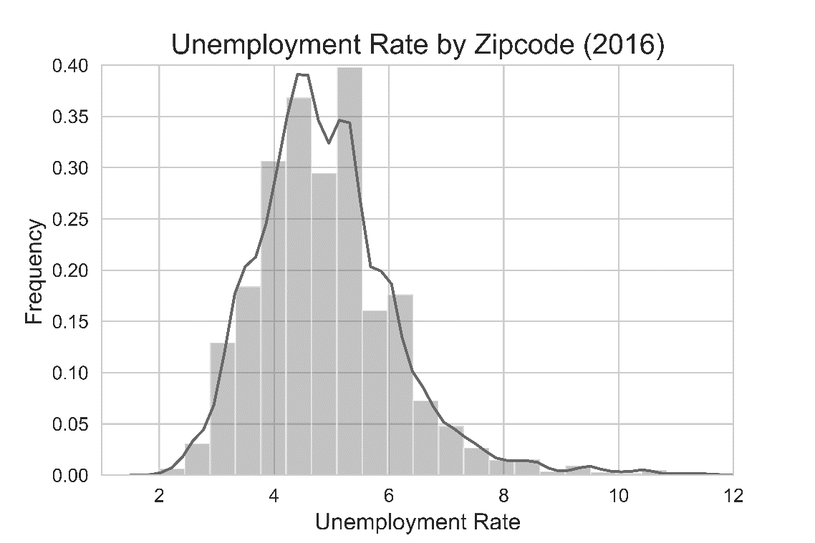
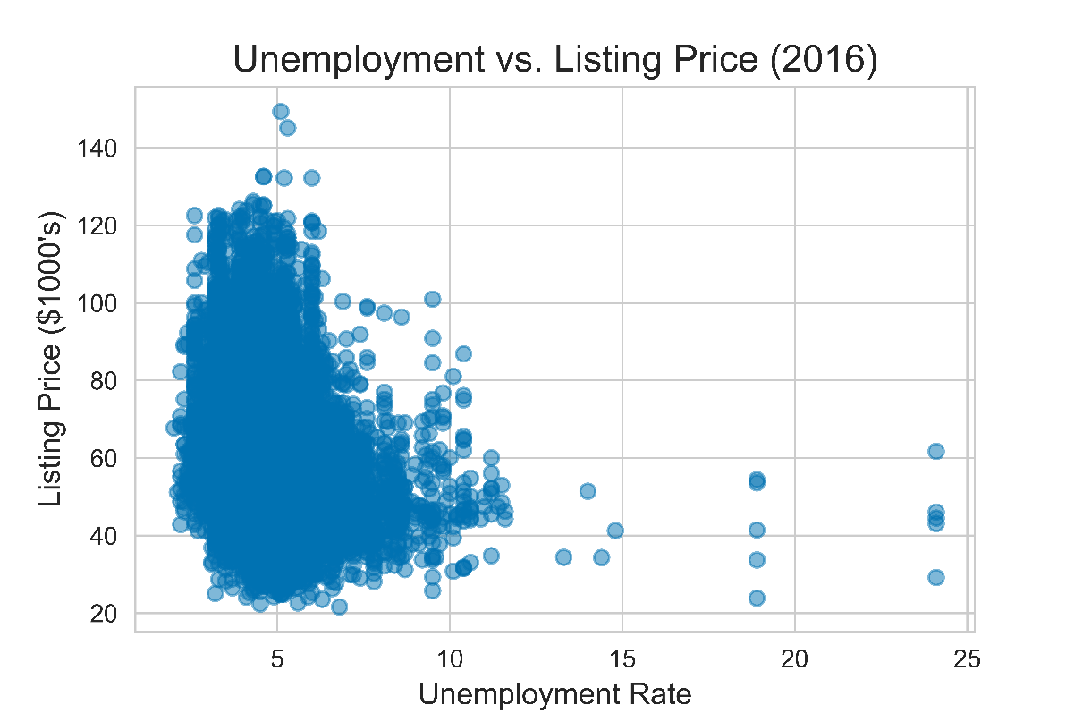
Exploratory Data Analysis Unemployment
Unemployment alone is not a strong predictor of home value

Slide 9
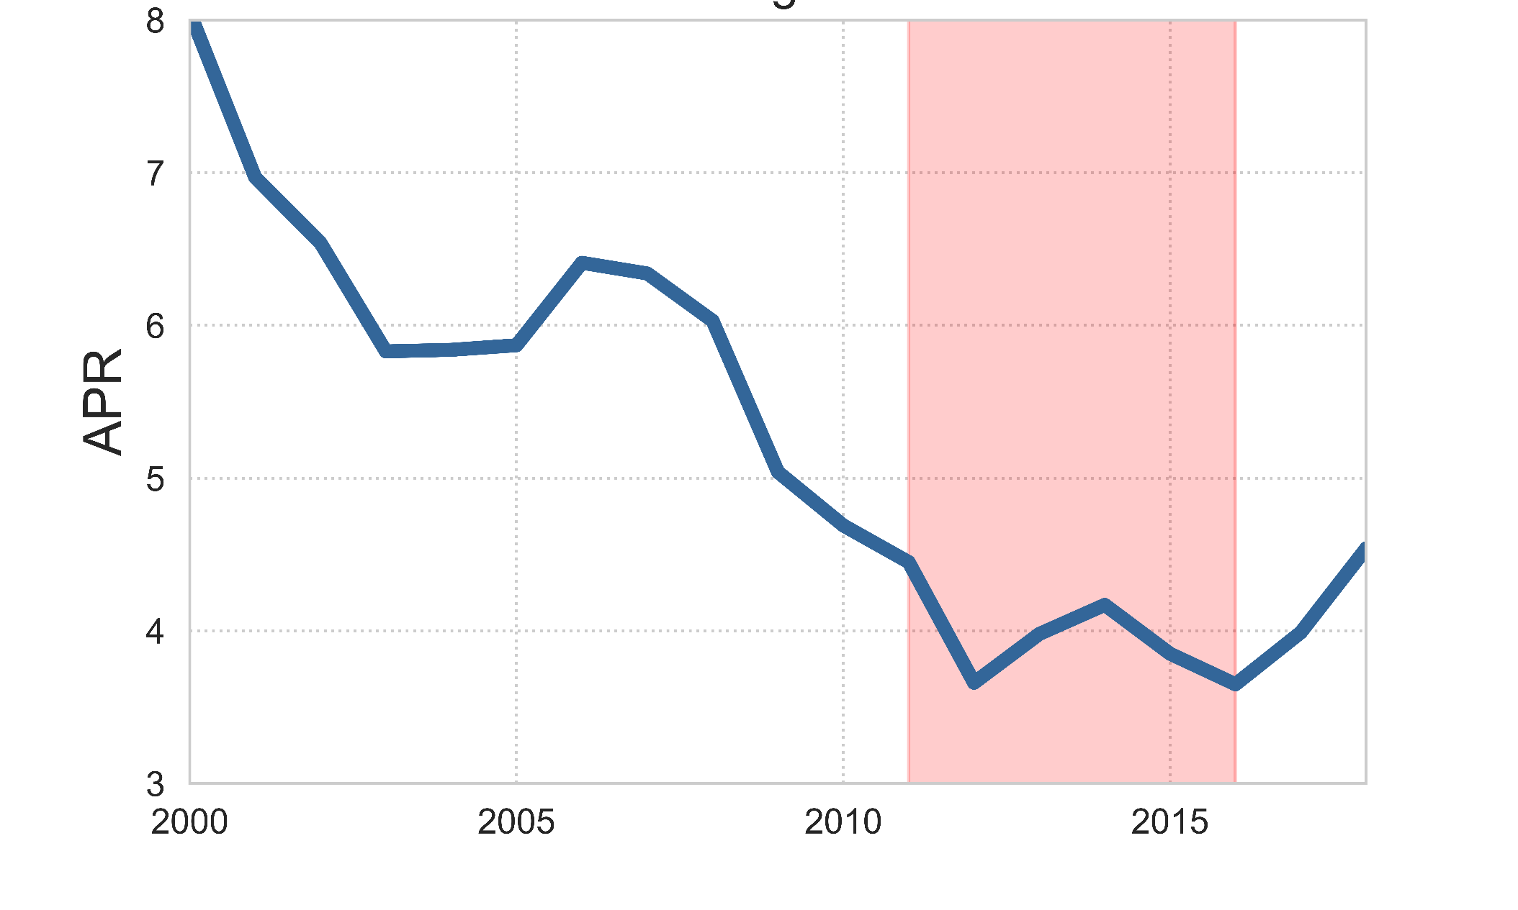
Exploratory Data Analysis Study period captured rates ranging from of 3.36 – 4.45%
30 year fixed rate Mortgage Rates

Slide 10
Model Selection Summary
We tried Lasso Regression
This was horrible
Resulted in an R^2 of less than .4
We tried Neural Networks
This made me want to cry
Did not learn anything pass the 2nd epoch
We tried Random Forest Linear Regression
This worked gloriously!
Able to obtain a 95% accuracy.

Slide 11
Model Explanation
We fed in 4 variables:
Zillow Size Rank
Incomes
Unemployment rate
30 Year Mortgage Rate
This gage us a training set of over 45,000 observations
Random Forest Parameters
We used a max depth of 30
A sample size of 500
Importance Levels
Size Rank = 22.5%
Unemployment = 8.5%
Mortgage Rates = 25%
Incomes = 66.5%

Slide 12
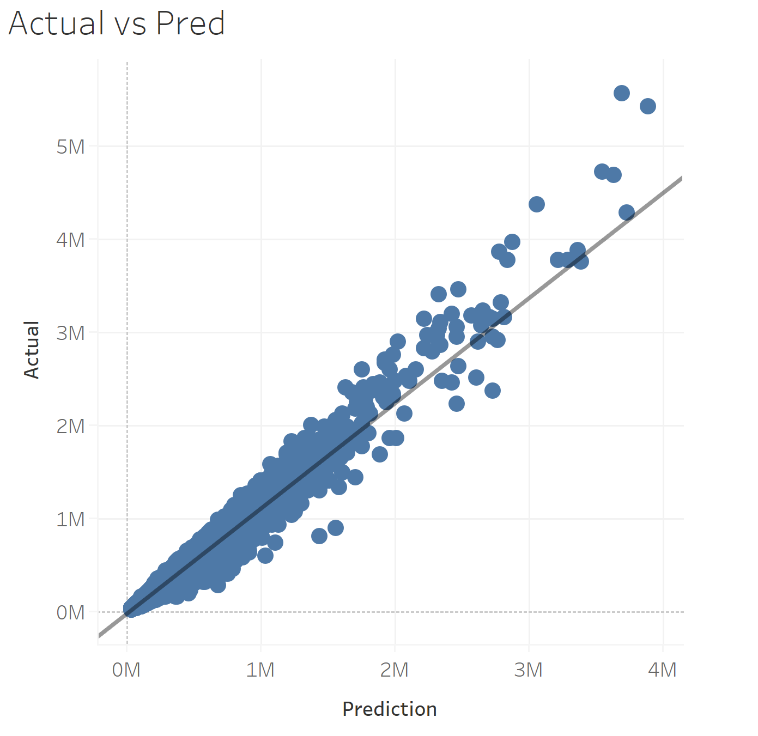
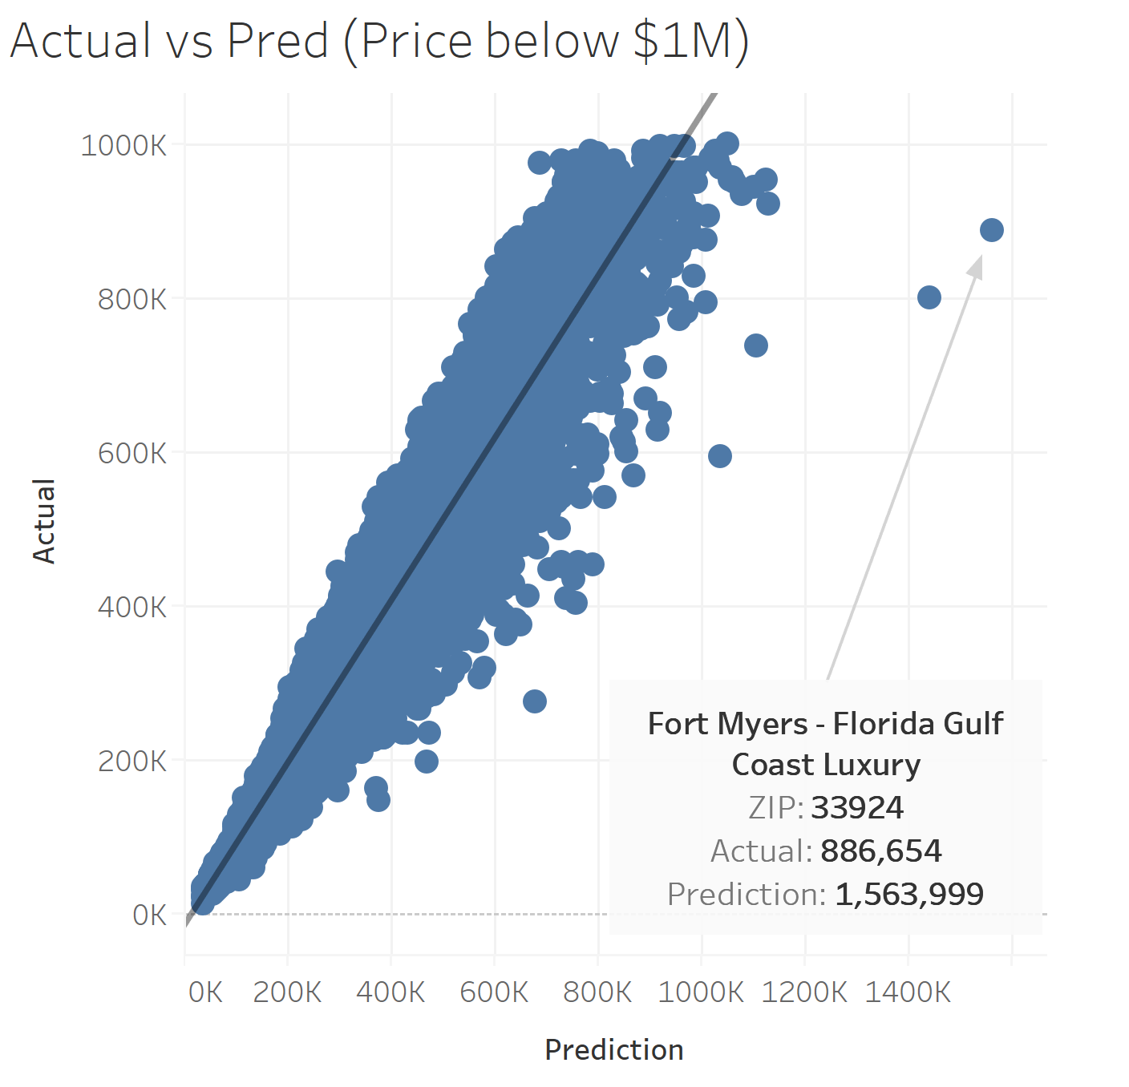
Accuracy Charts

Slide 13
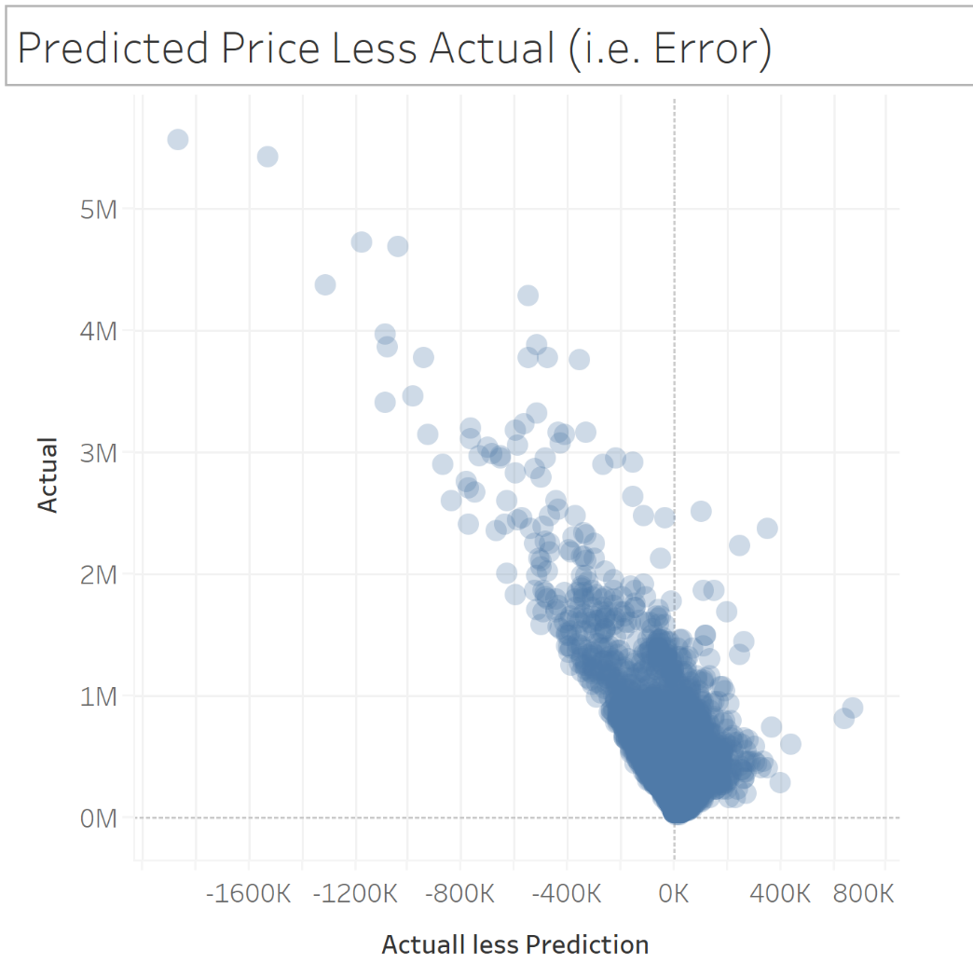
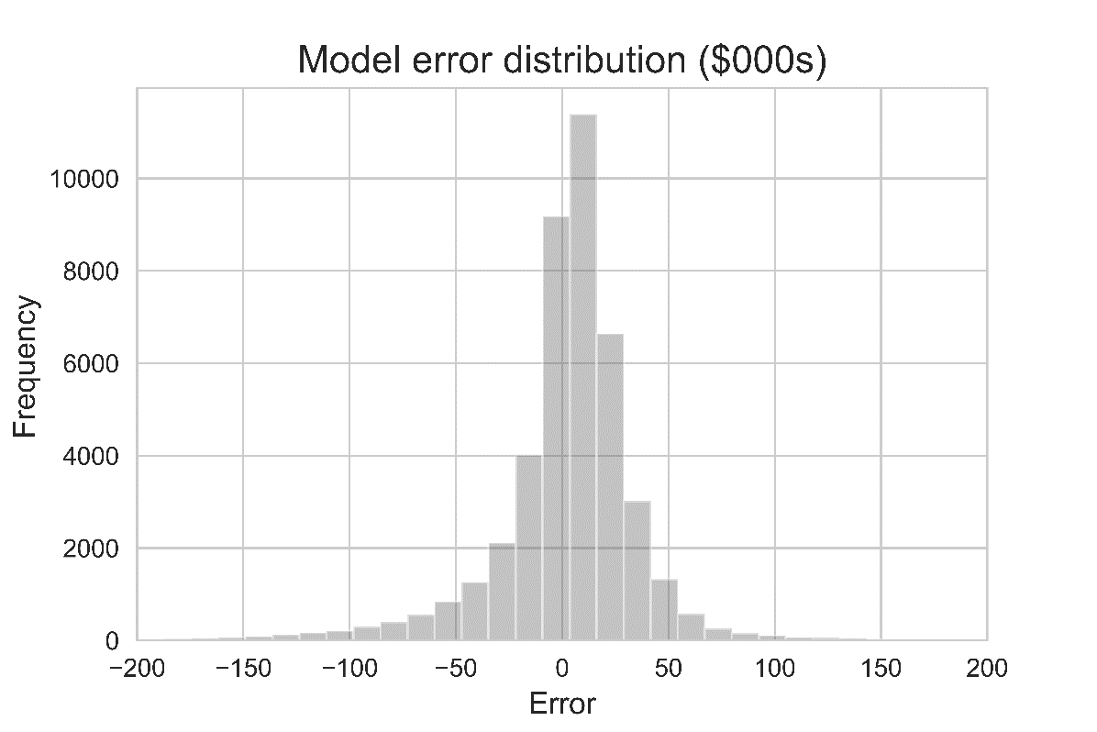
Error Analysis

Slide 14
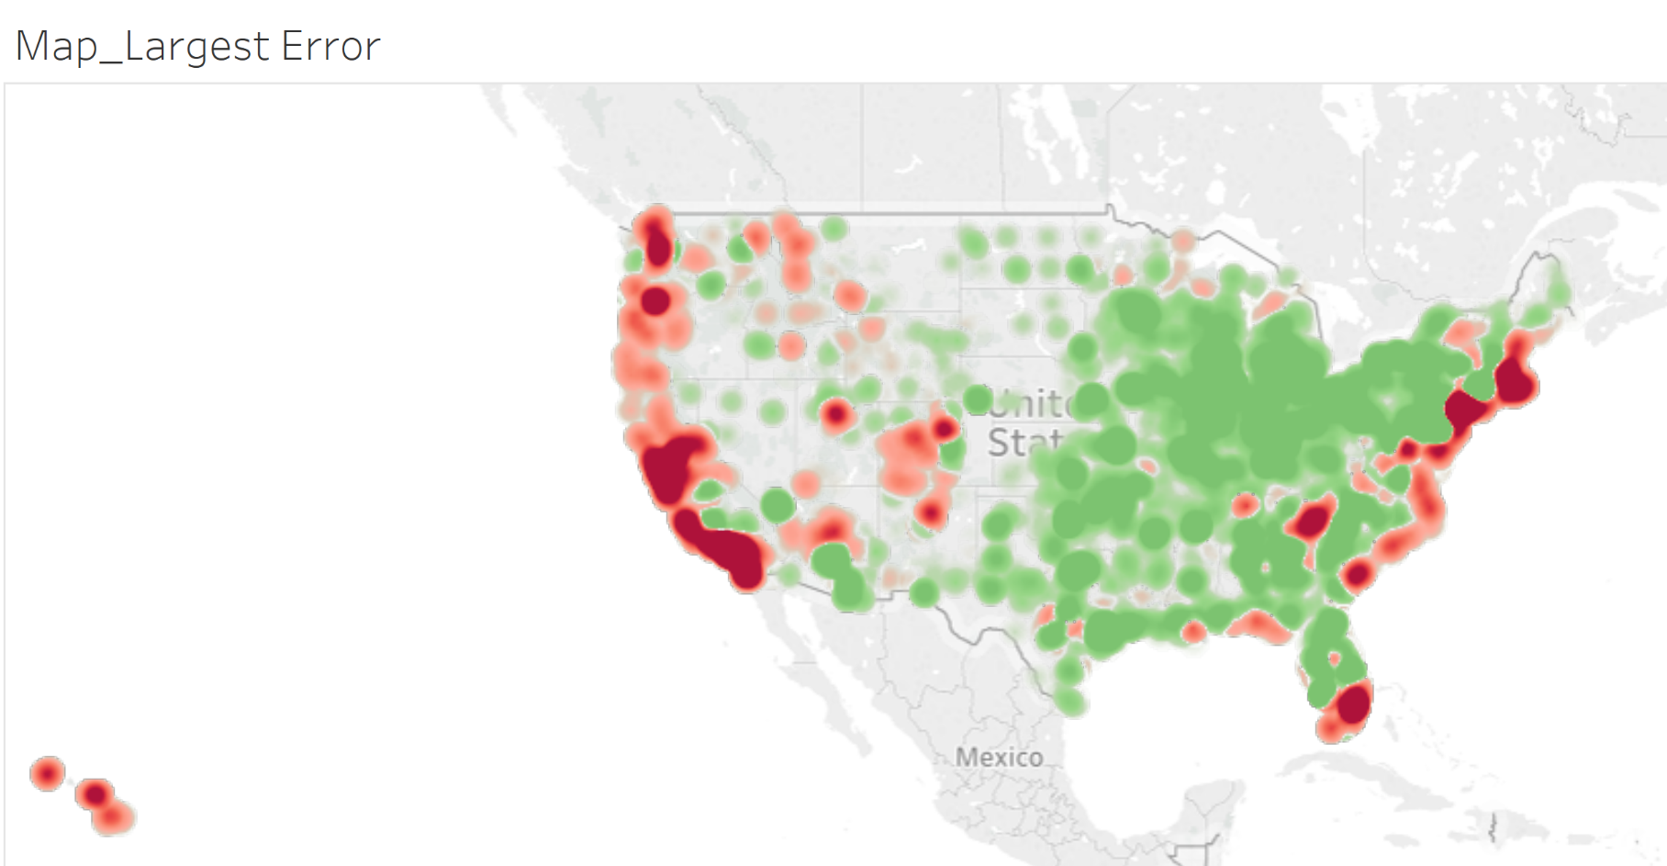
Analysis

Slide 15

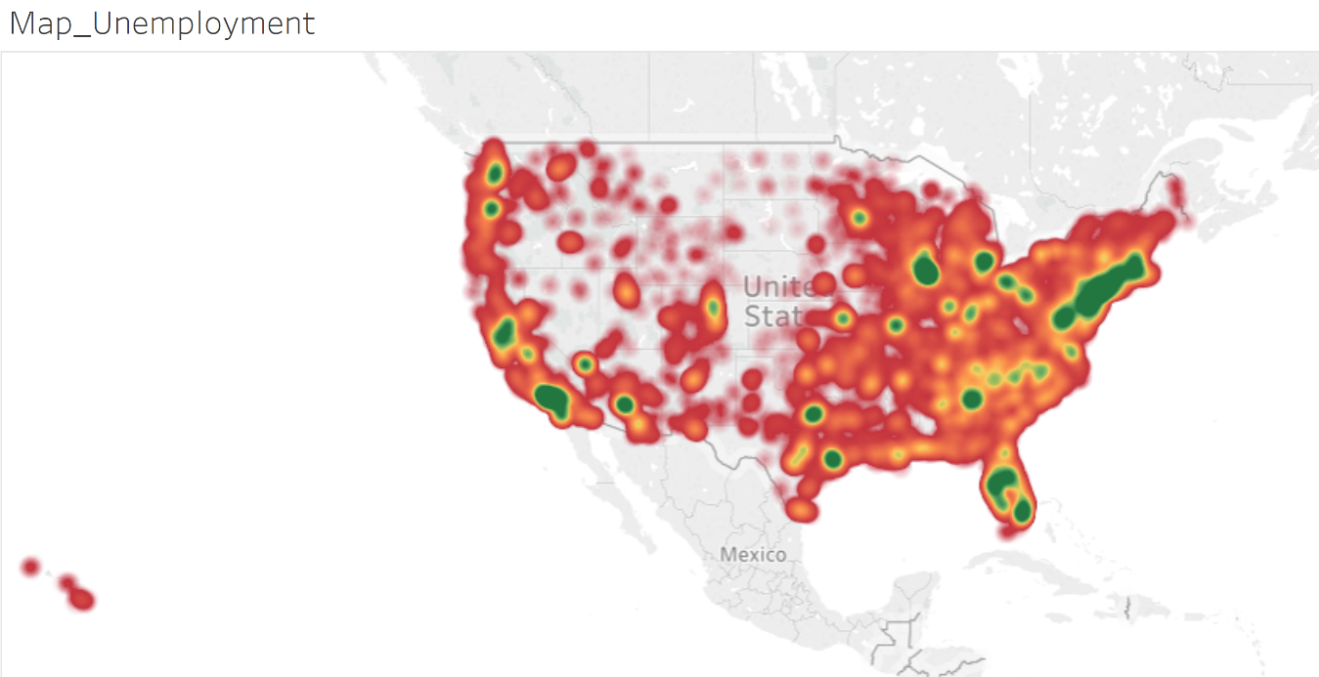
Relationships

Slide 16

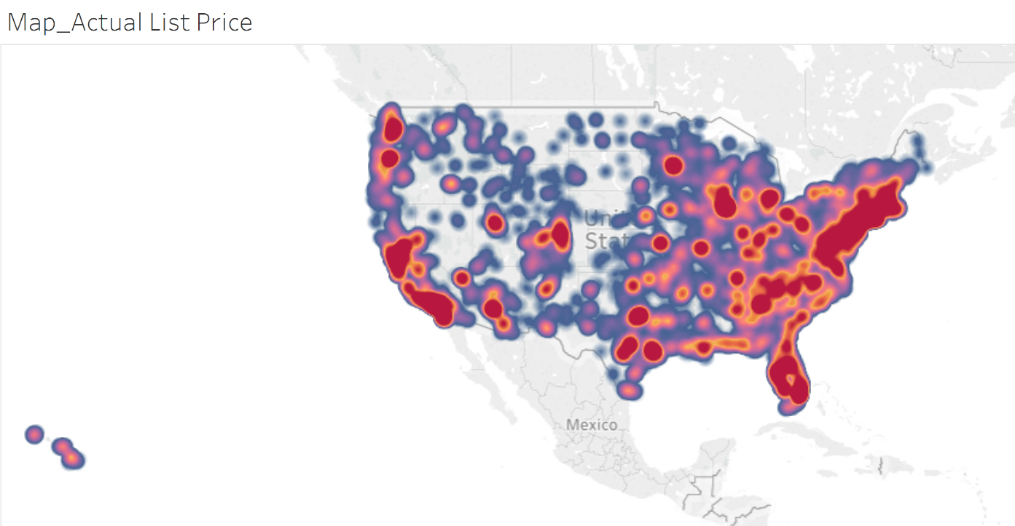
Relationships

